Slide 1

PROJECT ID: PUME025
B. Tech – Mechanical Engineering
7th Sem Major Project (303109406)
on
“Experimental Analysis of Pulsating Heat Pipe using different working fluids and Heat inputs”
Presented By:-
Bhayani Darshan (2303031097068)
Ninama Monika (2303031097080)
Sai Kumar Narakurthi (2303031097065)
Bariya Rahul (2203031097018)
Guided By:-Prof. Kamlesh Parmar
PARUL INSTITUTE OF ENGINEERING AND TECHNOLOGY, PARUL UNIVERSITY

Slide 2
BROAD OUTLINE
Introduction
List of Table
Literature Review
Research gap
Problem Definition
Aim & Objectives
Methodology
References
PARUL INSTITUTE OF ENGINEERING AND TECHNOLOGY, PARUL UNIVERSITY

Slide 3
LIST OF TABLE
SR. NO | Conventional Fluids | TR | dT | FR
1 | FC-72 | 9
2 | Water | 10-15 | 10-14 | 10,13-15
3 | R-134a | 14
4 | Ethanol | 9-11-16-18 | 17 | 10-17-18
5 | DI Water | 11,19-22 |  | 19,21,22
6 | Methanol | 11,12,23
7 | R-123 | 10,12,24 |  | 10,24
8 | Acetone | 11,12,25,26 | 27 | 25
TR = Thermal resistance (K·W⁻¹)
dT = Temperature difference (K)
FR = Filling ratio (%)
PARUL INSTITUTE OF ENGINEERING AND TECHNOLOGY, PARUL UNIVERSITY

Slide 4
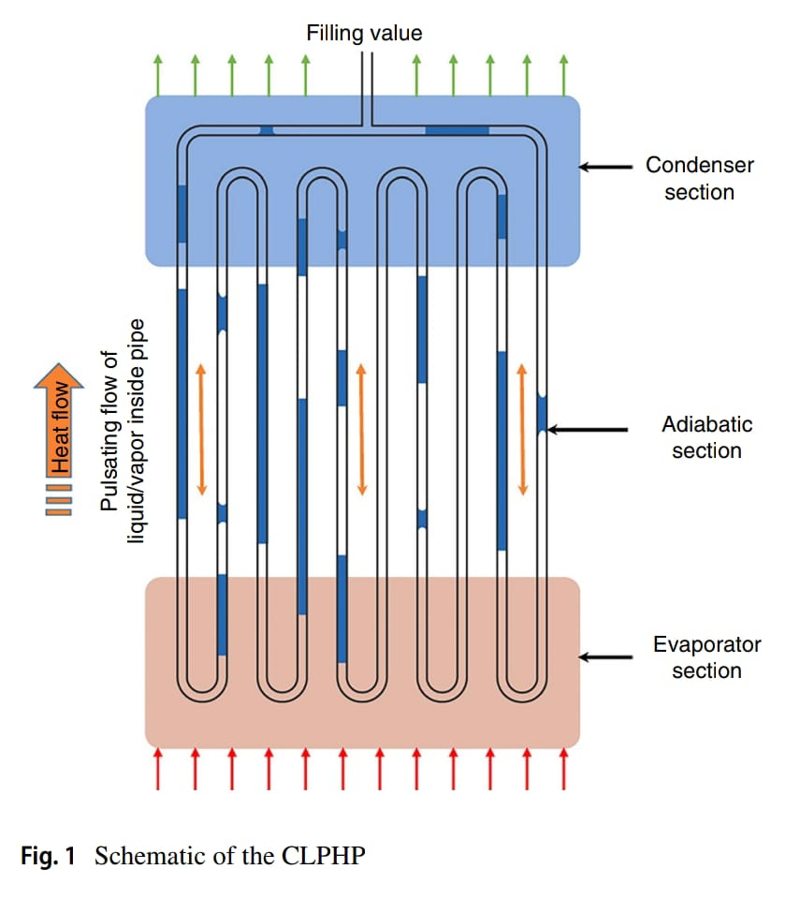
INTRODUCTION
Pulsating Heat Pipes (PHPs) are passive, wickless heat transfer devices based on phase change and fluid oscillation.
They are ideal for thermal control in compact systems like electronics, aerospace components, and electric vehicles.
PHPs function through the alternating movement of vapor bubbles and liquid slugs inside a capillary tube.
The choice of working fluid plays a crucial role in determining the thermal performance of PHPs.
Properties such as latent heat, surface tension, viscosity, and thermal conductivity influence heat transfer.
Varying heat inputs impact the amplitude and frequency of pulsations, directly affecting thermal efficiency.
Fig:- Schematic Of CLPHP [1]
PARUL INSTITUTE OF ENGINEERING AND TECHNOLOGY, PARUL UNIVERSITY

Slide 5
INTRODUCTION
The study uses experimental analysis to measure key parameters like temperature variation and heat transport rate.
Common fluids used in testing include water, ethanol, methanol, and acetone.
Startup Behaviour and ease of activation are also fluid and input dependent performance aspects.
The goal is to compare thermal resistance and effectiveness under different conditions.
Observations include response time, temperature uniformity, and stability of heat transfer.
Heat pipe orientation and filling ratio can also influence experimental results.
The analysis helps in identifying the most efficient fluid-heat input combination.
Insights from this study can lead to optimization in PHP design and configuration.
Overall, the result supports the development of high-performance thermal management system.
PARUL INSTITUTE OF ENGINEERING AND TECHNOLOGY, PARUL UNIVERSITY

Slide 6
LITERATURE REVIEW
No | Author | Title | Journal Name &Year | Remark
1 | Zaimaa Salsabil, Nusrat Yasmin, Farah Nazifa Nourin, Mohammad Ali, [2] | Effect of using ethanol and methanol on thermal performance of a closed loop pulsating heat pipe with different filling ratio. | Published in AIP Conference Proceedings/ July 2016 | Ethanol and methanol were tested in CLPHP under different filling ratios. Results help optimize working fluid selection for better heat transfer.
2 | Hua Han, Xiaoyu Cui, Yue Zhu, Shende Sun, [3] | A comparative study of the behavior of working fluids and their properties on the performance of pulsating heat pipes (PHP). | International Journal of Thermal Sciences/ May 7, 2014) | Studied water, methanol, ethanol, and acetone in CLPHP under different heat inputs and filling ratios. Dynamic viscosity affects startup; latent heat dominates at high input. At high power, fluid type has less impact due to system limits.
PARUL INSTITUTE OF ENGINEERING AND TECHNOLOGY, PARUL UNIVERSITY

Slide 7
LITERATURE REVIEW
No | Author | Title | Journal Name &Year | Remark
3 | Mahbuba Nusrat, Md. Ashiqur Rahman, Prof. Dr. Aloke Kumar Mozumder [4] | Study on thermal performance of a CLPHP using different working fluid with or without insert. | Department of Mechanical Engineering, Bangladesh University of Engineering & Technology (BUET)/ March 2023 | CLPHP tested with water, ethanol, and acetone at different heat inputs and filling ratios. Performance compared with and without rosette fin inserts. Optimal conditions identified for improved heat transfer in electronics cooling.
4 | Rasel A Sultan[5] | Experimental Study of a Pulsating Heat Pipe aiming at optimized operational condition. | This document is identified as a "Technical Report" and "Term Paper ENGI 9627, Fall 2015"./November 2015 | Study focuses on pulsating heat pipes (PHP) with serpentine tube design. Aims to improve heat transfer efficiency. Targets optimization of operating conditions and cost-effectiveness.
PARUL INSTITUTE OF ENGINEERING AND TECHNOLOGY, PARUL UNIVERSITY

Slide 8
LITERATURE REVIEW
No | Author | Title | Journal Name &Year | Remark
5 | E. R. , G. V. Gnanendra Reddy [6] | Effect of Working Fluid and Filling Ratio on Performance of a Closed Loop Pulsating Heat Pipe. | Journal of Engineering Science and Technology/ June 2016 | Studied effect of different fluids and filling ratios on CLPHP at 10–22 W heat input. Thermal resistance reduced as heat input increased. Acetone gave best performance; optimal filling ratio was 40–50%.
6 | J. Venkata Suresh, Dr. P. Bhramara , CH. Navaneeth [7] | Effect of Filling Ratio on Thermal Characteristics and Performance of a Pulsating Heat Pipe. | International Journal of Innovative Technology and Exploring Engineering (IJITEE)/ 2019 | CLPHP tested with water and benzene at 50% filling and 20–80 W heat input. Benzene performed better at 45° inclination; thermal resistance decreased with input. CFD simulations matched experimental results within 10% error.
PARUL INSTITUTE OF ENGINEERING AND TECHNOLOGY, PARUL UNIVERSITY

Slide 9
LITERATURE REVIEW
No | Author | Title | Journal Name &Year | Remark
7 | J. Venkata Suresh, Dr. P. Bhramar, A. Sai Kalyan, Md. Abdul Khaleel, K. Sathwik [8] | A Review on Pulsating Heat Pipe with Different Working Parameters Affecting the Performance. | E3S Web of Conferences ICMPC 2023/ 2023 | Reviews factors affecting PHP performance like tube size, filling ratio, and fluid type. Highlights the impact of heat input and geometry on efficiency. Optimizing parameters improves cooling, especially for electronics.
8 | Pramod R. Pachghare , Ashish M. Mahalle , Shekhar Khedkar [9] | Effect of Working Fluid on Thermal Performance of Closed Loop Pulsating Heat Pipe. | Proceedings of the National Conference on Innovative Paradigms in Engineering & Technology/2012 | Reviews impact of working fluids, tube diameter, and filling ratio on CLPHP performance. Emphasizes fluid selection as key to effective heat transfer. Identifies gaps in startup behavior and fluid mixture studies.
PARUL INSTITUTE OF ENGINEERING AND TECHNOLOGY, PARUL UNIVERSITY

Slide 10
LITERATURE REVIEW
No | Author | Title | Journal Name &Year | Remark
9 | Dr. T. Hari Prasad, Pol Reddy Kukutla, P. Mallikarjuna Rao, R. Meenakshi Reddy [10] | Experimental Investigation on Performance of Pulsating Heat Pipe. | Proceedings of the ASME 2015 Gas Turbine India Conference/December 2015 | CLPHP tested with water at 50% filling and various inclinations (0°, 45°, 90°). Thermal resistance decreased and heat transfer coefficient increased with heat input. Vertical (90°) orientation gave the best performance.
10 | Rasel A. Sultan, M. Lutfor Rahman [11] | Closed Loop pulsating pipe. | LAP Lambert Academic Publishing/June 2015 | CLPHP performance studied using ethanol and methanol at various inclinations. Tested with and without fins/inserts to compare thermal effects. Best performance observed with methanol and fin-inserts at 45° angle.
PARUL INSTITUTE OF ENGINEERING AND TECHNOLOGY, PARUL UNIVERSITY

Slide 11
LITERATURE REVIEW
No | Author | Title | Journal Name &Year | Remark
11 | Kamlesh Parmar Ibrahim Nagme Sachin Thakur Abhishek Singh Ajit Kumar Parwani Sumit Tripathi Nirmal Parmar[12] | Thermal Performance Comparison of Closed Loop Pulsating Heat Pipe with DI Water and Al₂O₃/DI Nanofluid | AIP Conference Proceedings, Volume 2960, Recent Advances in Mechanical Infrastructure Publisher: AIP Publishing | CLPHP tested with DI water and Al₂O₃/DI nanofluid at 40% and 60% filling ratios. Experiments conducted under 350 W heat input. Al₂O₃/DI nanofluid showed lower thermal resistance, best at 60% filling.
12 | Kamlesh Parmar, Nirmal Parmar, Ajit Kumar Parwani, and Sumit Tripathi[13] | Experimental and ML-based analysis of CLPHP using Al₂O₃–DI water nanofluid. | Journal of Thermal Analysis and Calorimetry/December 16, 2024; assigned to the January 2025 | CLPHP tested using DI water and Al₂O₃/DI nanofluid under varying conditions. Machine learning models (Random Forest, KNN) used to predict thermal parameters. Nanofluid reduced thermal resistance; ML showed high accuracy (R² ≈ 0.99).
PARUL INSTITUTE OF ENGINEERING AND TECHNOLOGY, PARUL UNIVERSITY

Slide 12
RESEARCH GAP
Limited Comparative Study Between Polar Fluids:-Although water, ethanol, and methanol are commonly used in CLPHPs, there is limited comparative research focusing on how their molecular polarity, latent heat, and viscosity differences affect performance under identical conditions.
Lack of Analysis on DI Water vs. Normal Water Performance:-There is insufficient research comparing distilled water and tap water or normal water in CLPHPs. The effect of water purity on heat transfer and fluid circulation remains unclear.
Inadequate Optimization for Different Fluids Across Filling Ratios:-Many studies test a few fixed filling ratios. However, optimal filling ratio varies with fluid properties (e.g., viscosity, surface tension), and this relationship is not well-established, especially between alcohol-based fluids and water.
Under-Explored Influence of Thermo-Physical Properties on Start-Up Time:- The start-up behavior of CLPHPs depends heavily on the fluid's boiling point and surface tension. There is a lack of systematic study comparing how fluids like ethanol and methanol differ from water in start-up time and pulsating stability.
Lack of Performance Data at Lower Heat Inputs:-Most existing research uses moderate to high heat inputs. The performance of water and alcohol-based fluids in CLPHPs under low heat flux conditions (relevant to electronics cooling) has not been widely studied.
Neglect of Combined Effects (fluid + orientation + fill ratio):-While studies exist on working fluids, orientation, and fill ratio separately, the combined impact of all three factors for fluids like ethanol and methanol is rarely investigated in a single controlled study.
PARUL INSTITUTE OF ENGINEERING AND TECHNOLOGY, PARUL UNIVERSITY

Slide 13
PROBLEM DEFINITION
Closed Loop Pulsating Heat Pipes (CLPHPs) are widely studied for their potential in passive and compact heat transfer applications.
The performance of CLPHPs is highly dependent on working fluid properties, filling ratio, and pipe orientation.
Although fluids like water, ethanol, and methanol have been used in previous research, comparative studies under identical conditions are still limited.
The effect of water purity, such as distilled water (DI water) vs. regular water, on thermal performance and start-up behavior has not been fully explored.
Existing research often studies fluid type, filling ratio, or orientation separately, but rarely considers their combined effect in a single experimental setup.
There is a lack of systematic experimental data on the thermal resistance, heat transfer efficiency, and start-up time for these four fluids across varying conditions.
To address these gaps, the present study will conduct an experimental analysis using water, DI water, ethanol, and methanol as working fluids.
The aim is to identify the optimal working fluid and operating conditions for improved CLPHP performance, which can benefit real-world thermal management systems.
PARUL INSTITUTE OF ENGINEERING AND TECHNOLOGY, PARUL UNIVERSITY

Slide 14
AIM & OBJECTIVES
Aim:- To experimentally evaluate and compare the thermal performance of a Closed Loop Pulsating Heat Pipe (CLPHP) using water, DI water, ethanol, and methanol under different filling ratios.
Objectives:-
To study the effect of different working fluids (water, DI water, ethanol, methanol) on CLPHP performance.
To analyze how varying filling ratios influence thermal resistance and start-up behavior.
To identify the most suitable fluid and operating condition for efficient heat transfer.
To generate experimental data useful for future research and system optimization.
PARUL INSTITUTE OF ENGINEERING AND TECHNOLOGY, PARUL UNIVERSITY

Slide 15
METHODOLOGY
To study the thermal performance of CLPHP using water, DI water, ethanol, and methanol.
A CLPHP is fabricated with required components like evaporator, condenser, heater, and thermocouples.
Choose four working fluids and fill them at different filling ratios (40%, 60%, 80%).
Test each fluid under different orientations (vertical ) and heat inputs.
Record temperature difference, start-up time, and thermal resistance for each condition.
Compare fluids based on performance metrics and identify the most efficient combination.
Recommend the best working fluid and filling ratio for optimal CLPHP efficiency.
Probable Solution:
Efficient working fluid and ideal operating condition for enhanced passive heat transfer using CLPHP.
PARUL INSTITUTE OF ENGINEERING AND TECHNOLOGY, PARUL UNIVERSITY

Slide 16

METHODOLOGY
FIG:- CLOSED LOOP PULSATING HEAT PIPE
PARUL INSTITUTE OF ENGINEERING AND TECHNOLOGY, PARUL UNIVERSITY

Slide 17
ESTIMATION REPORT
Sr. No. | Components | Quantity | Approx. Price INR
1 | K-Type Thermocouple | 09 | 5000-7000
2 | Vaccum-Pressure Gauge(Upto 760mm hg) | 01 | 890-1200
3 | Variac (Auto Transformer) | 01 | 3950-5500
4 | Data Logger | 01 | 15000
5 | Heat Plate | 02 | 1200-1500
6 | Insulation(Glass-Wool/Aluminium Foil) | - | 300-500
7 | Working Fluid (Water,Ethanol etc) | - | 600-1000
8 | Aluminium Tape | 01 | 150-200
9 | Copper Pipe+Support Frame | - | 800-1000
10 | Multimeter/Ammeter-Voltmeter | 01 | 500-800
PARUL INSTITUTE OF ENGINEERING AND TECHNOLOGY, PARUL UNIVERSITY

Slide 18
REFERENCES
A Review on Recent Advances in Pulsating Heat Pipes January 2022DOI: 10.1007/978-981-16-7660-4_8 https://www.researchgate.net/publication/357548372_A_Review_on_Recent_Advances_in_Pulsating_Heat_Pipes
Salsabil, Z., Yasmin, N., Nourin, F. N., & Ali, M. (2016). Effect of using ethanol and methanol on thermal performance of a closed loop pulsating heat pipe (CLPHP) with different filling ratios. AIP Conference Proceedings. https://doi.org/10.1063/1.4958405
Han, H., Cui, X., Zhu, Y., & Sun, S. (2014). A comparative study of the behavior of working fluids and their properties on the performance of pulsating heat pipes (PHP). International Journal of Thermal Sciences, 82, 1–10. https://doi.org/10.1016/j.ijthermalsci.2014.04.003
Nusrat, M., & Rahman, M. A. (2023). Study on thermal performance of a closed loop pulsating heat pipe using different working fluids with & without insert (Undergraduate thesis). Department of Mechanical Engineering, BUET. https://doi.org/10.13140/RG.2.2.29989.92648
Sultan, R. A., & Rahman, M. L. (2015). Closed Loop Pulsating Heat Pipe. LAP Lambert Academic Publishing. https://www.researchgate.net/publication/295861745_Closed_Loop_Pulsating_Heat_Pipe
Babu, E. R., & Reddy, G. V. G. (2016). Effect of working fluid and filling ratio on performance of a closed loop pulsating heat pipe. Journal of Engineering Science and Technology, 11(6), 872–880.
PARUL INSTITUTE OF ENGINEERING AND TECHNOLOGY, PARUL UNIVERSITY

Slide 19
REFERENCES
Suresh, J. V., Bhramara, P., & Navaneeth, C. H. (2019). Effect of filling ratio on thermal characteristics and performance of a pulsating heat pipe. International Journal of Innovative Technology and Exploring Engineering, 9(2), 3346–3351. https://doi.org/10.35940/ijitee.A4641.129219
Suresh, J. V., Bhramara, P., Kalyan, A. S., Khaleel, M. A., & Sathwik, K. (2023). A review on pulsating heat pipe with different working parameters affecting the performance. E3S Web of Conferences, ICMPC 2023. https://doi.org/10.1051/e3sconf/202343001291291
Pachghare, P. R., Mahalle, A. M., & Khedkar, S. (2012). Effect of working fluid on thermal performance of closed loop pulsating heat pipe: A review. Proceedings of the National Conference on Innovative Paradigms in Engineering & Technology (NCIPET-2012). International Journal of Computer Applications®.
Hari Prasad, T., Kukutla, P. R., Rao, P. M., & Reddy, R. M. (2015). Experimental investigation on performance of pulsating heat pipe. Proceedings of the ASME 2015 Gas Turbine India Conference (GTINDIA2015). https://doi.org/10.1115/GTINDIA2015-1362
Unnamed Authors. (n.d.). Experimental study on the thermal performance of a CLPHP using water, ethanol, and acetone with and without rosette fin inserts under various filling ratios and heat inputs [Thesis image summary]. (Referenced from uploaded image).
Parmar, K., Nagme, I., Thakur, S., Singh, A., Parwani, A. K., Tripathi, S., & Parmar, N. (2024). Thermal performance comparison of closed loop pulsating heat pipe with DI water and Al₂O₃/DI nanofluid. AIP Conference Proceedings, 2960(1), 040005. https://doi.org/10.1063/5.0183494
PARUL INSTITUTE OF ENGINEERING AND TECHNOLOGY, PARUL UNIVERSITY

Slide 20
REFERENCES
Parmar, K., Parmar, N., Parwani, A. K., & Tripathi, S. (2025). Experimental studies and machine learning approaches for thermal parameters prediction and data analysis in closed-loop pulsating heat pipes with Al₂O₃–DI water nanofluid. Journal of Thermal Analysis and Calorimetry. https://doi.org/10.1007/s10973-024-13859-1
PARUL INSTITUTE OF ENGINEERING AND TECHNOLOGY, PARUL UNIVERSITY

